Slide 1
Using Generalized Linear Model To Predict Stock Performance
Minchan Shi
12/10/2020

Slide 2
What I Will Be Talking About
Introduction
Data Description and Diagnostics
Data Analysis and Main Results
Conclusion

Slide 3

Problem Statement & Motivation
Predicting &forecasting stock price(GDX)

Slide 4
Methods and Data Diagnostics
Data Processing
Regression Analysis
Evaluation Of The Model
Data Visualization
Descriptive Statistics

Slide 5
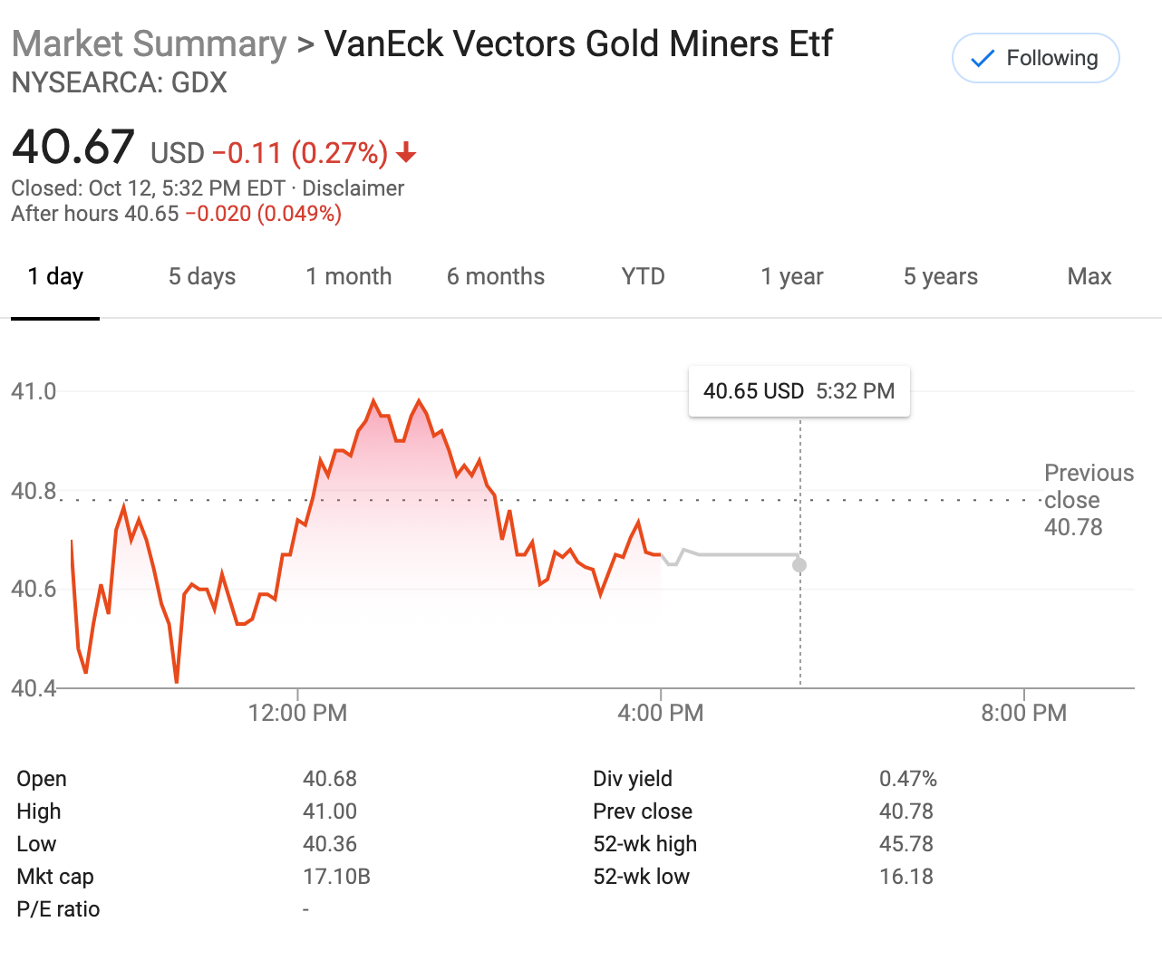
Data Description
The dataset is from yahoo finance historical database.<”https://finance.yahoo.com/quote/GDX/performance?p=GDX
VanEck Vectors Gold Miners ETF (GDX)
1259 sample size
“Date” , “Open” , “High” , “Low” , “Close” , “Adj.Close”, “Volume” . “Nextday”, “Profit_In_Percentag 1e”, “Month” ,“Year” .

Slide 6
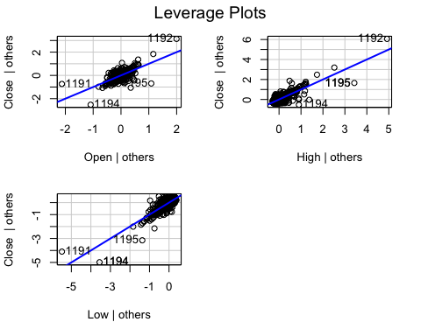
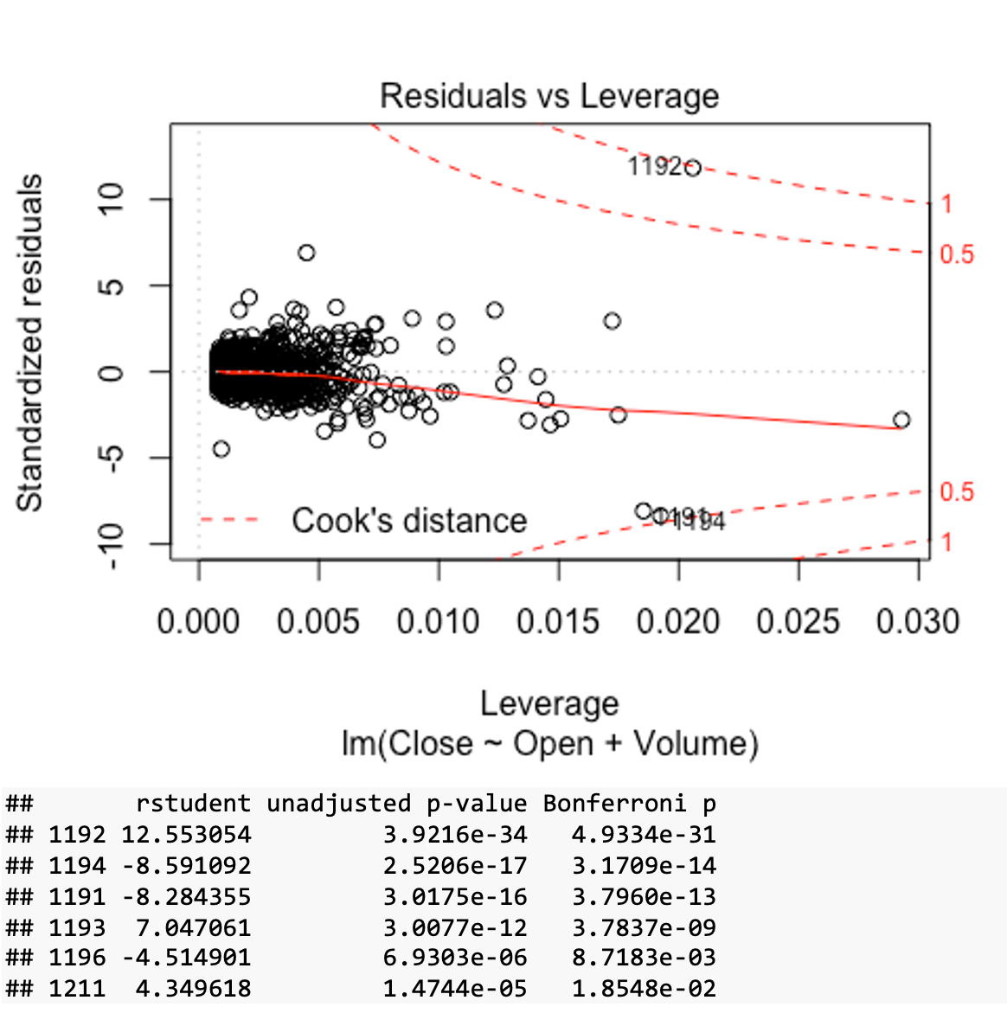
Data Diagnostics Outlier appears One NA value

Slide 7
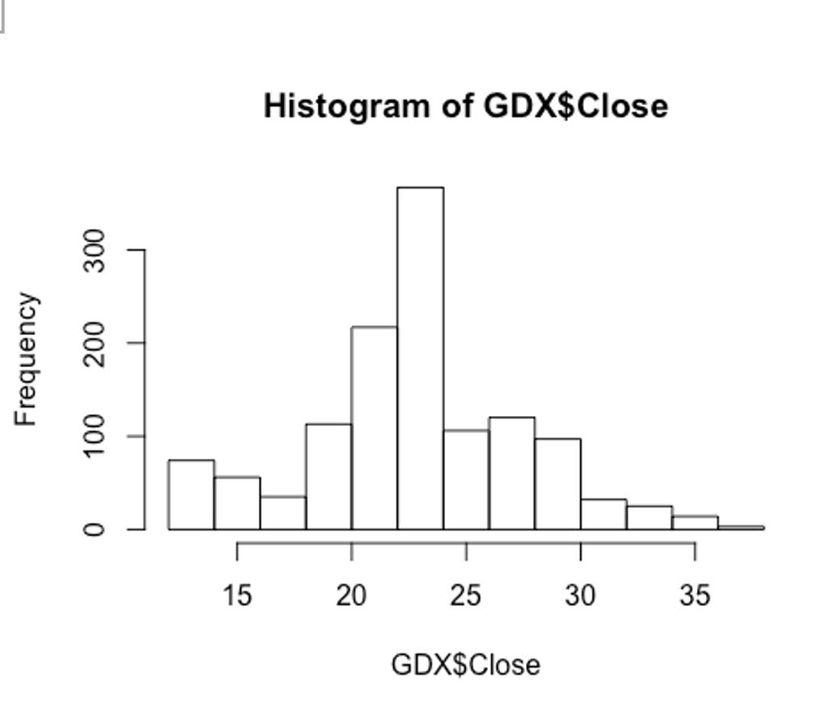
Close to normal distribution
Kolmogorov-Smirnov test
Shapiro-Wilks test
skewness ：0.07943889
kurtosis ： 3.213588

Slide 8
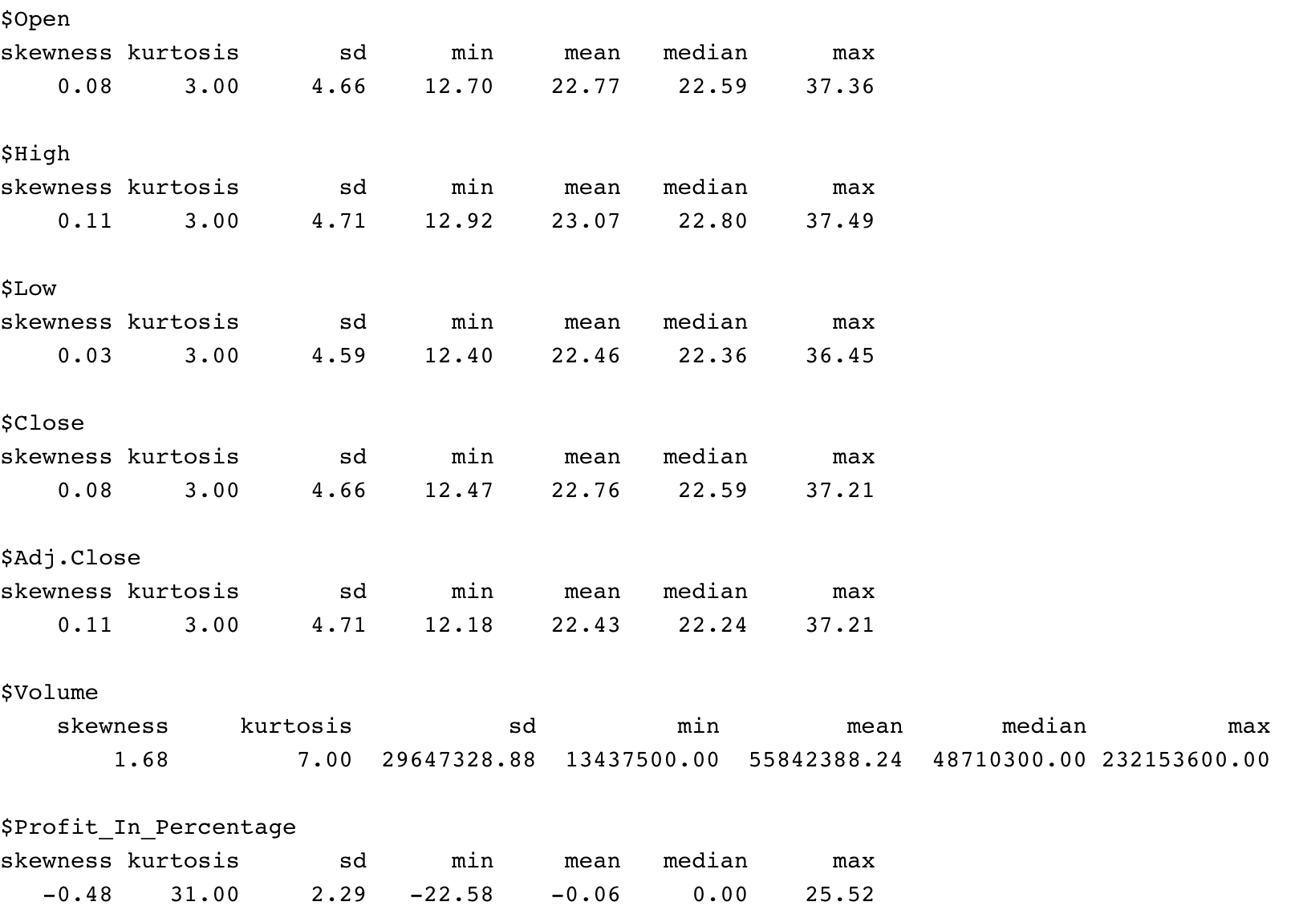
Descriptive Statistics

Slide 9
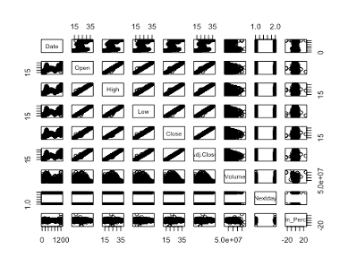
High Correlation

Slide 10
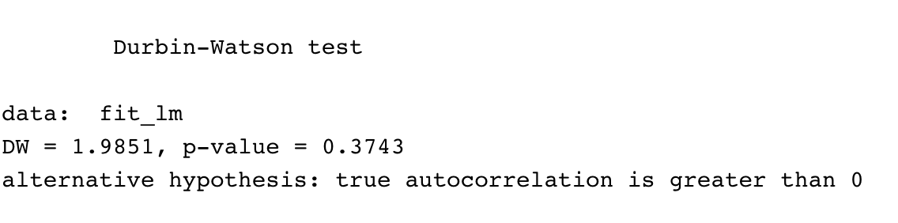
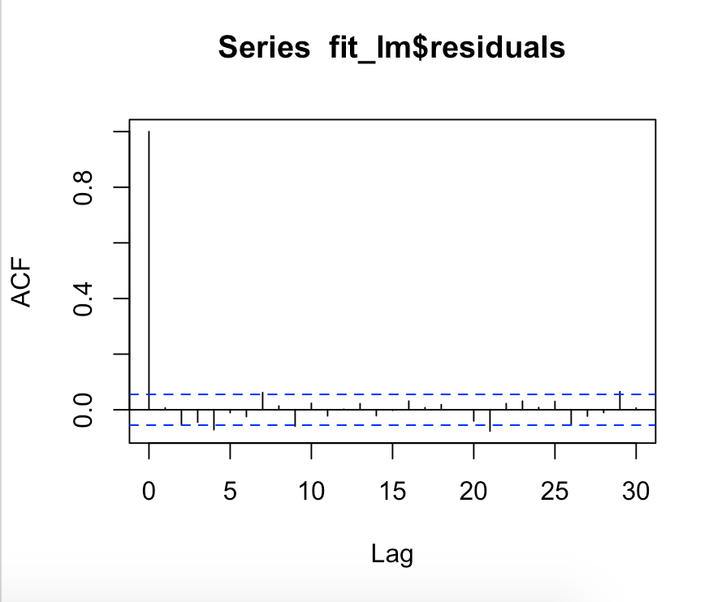
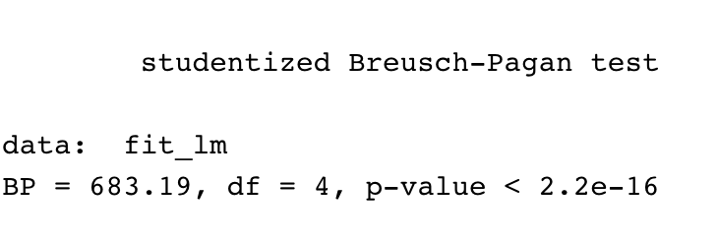
The Durbin-Watson test statistic tests the null hypothesis
that the residuals from an ordinary least-squares regression are not autocorrelated
Auto-correlation test
Null hypothesis: the variance is unchanging in the residuals
Alternative hypothesis: the variance is changing in the residuals

Slide 11
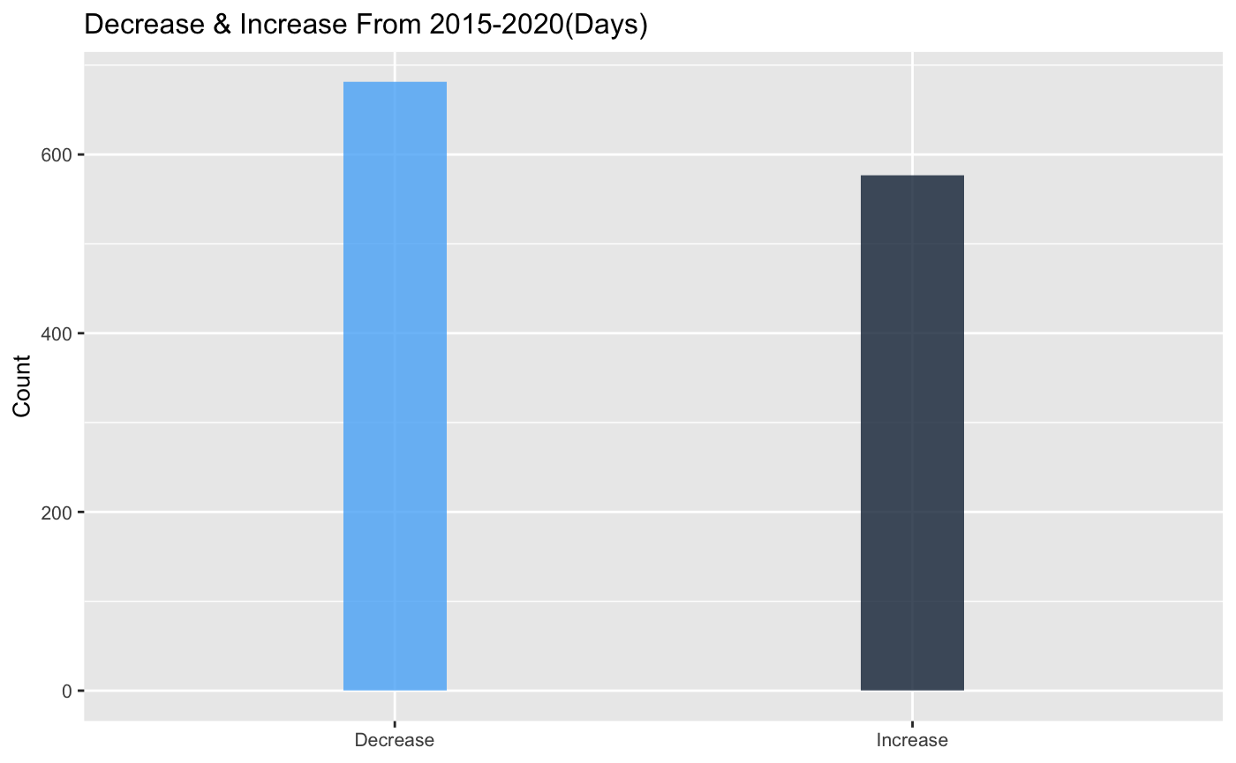
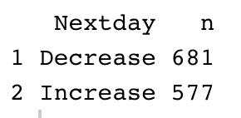
visualization

Slide 12
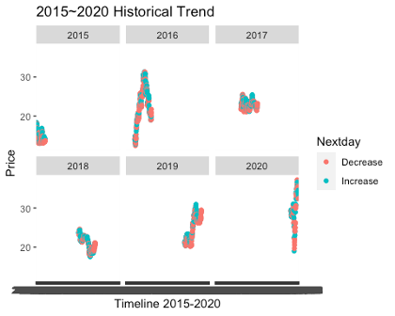
visualization

Slide 13
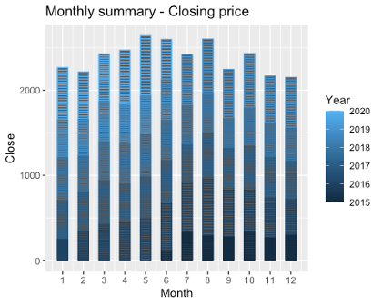
May & JUNE & august Price is on the side
nov & dec & feb Price is on the low side

Slide 14
How has the return on investment performed over the last five years?

Slide 15
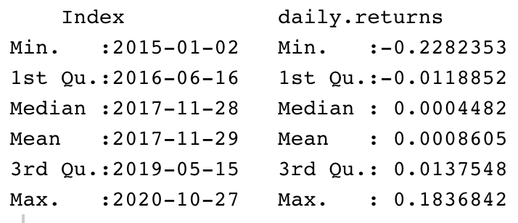
Earning and returns_Unit %

Slide 16
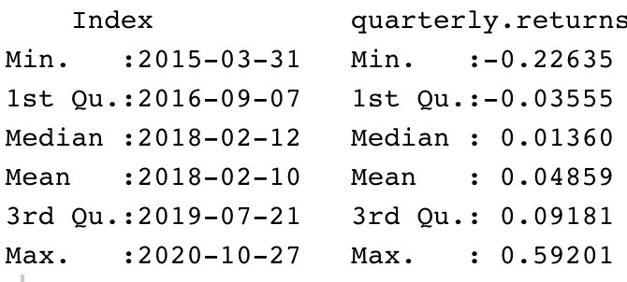
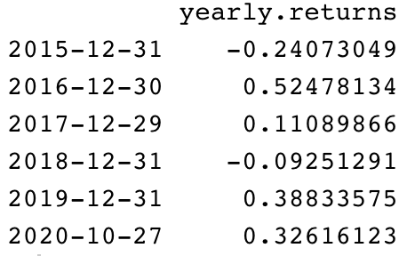
Earning and returns_Unit %

Slide 17
Generalized Linear Model

Slide 18
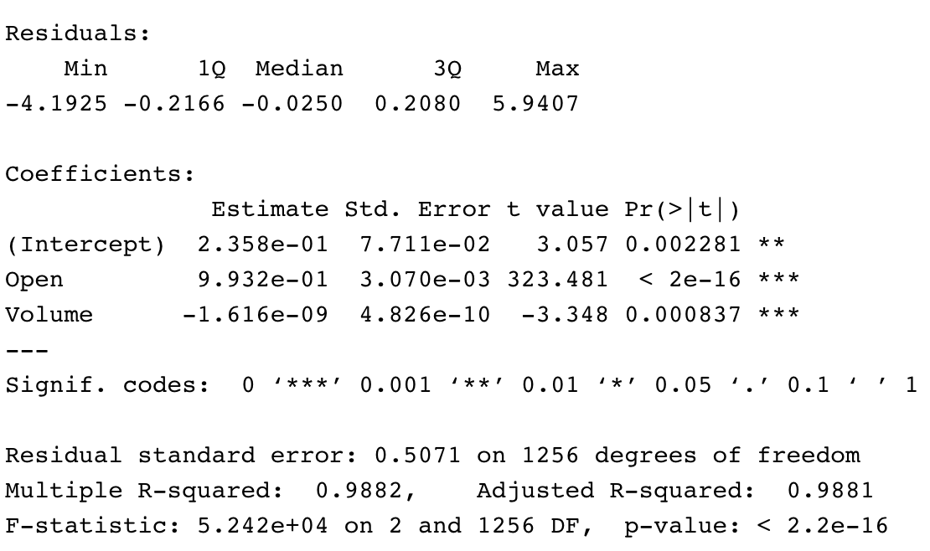
Model Result
P-value ***
R-squared ~ 0.99
ANOVA
Test result indicates F=3329 , Pr(>F) 2.2e-16 ***
BIC/VIF preformed

Slide 19
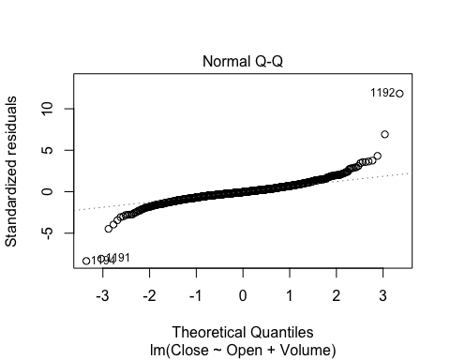
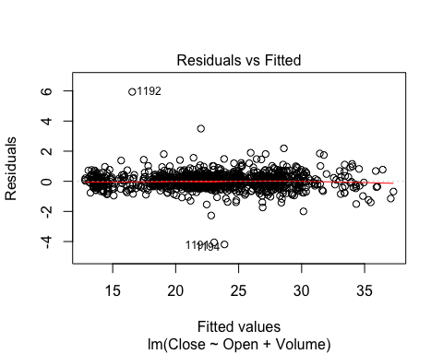
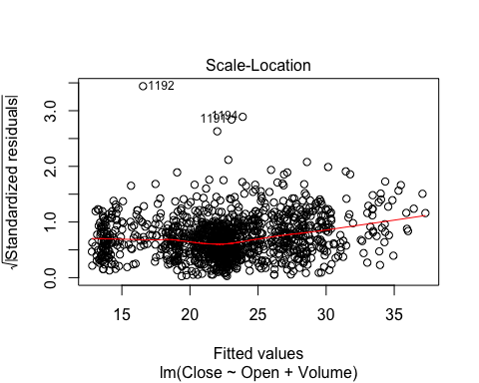

Slide 20
Around 25% error

Slide 21
Logistic regression was used to predict the probability of a daily rise or fall, and the accuracy was 55%
Predict
Decrease
Increase
Decrease
656
25
Increase
547
30

Slide 22
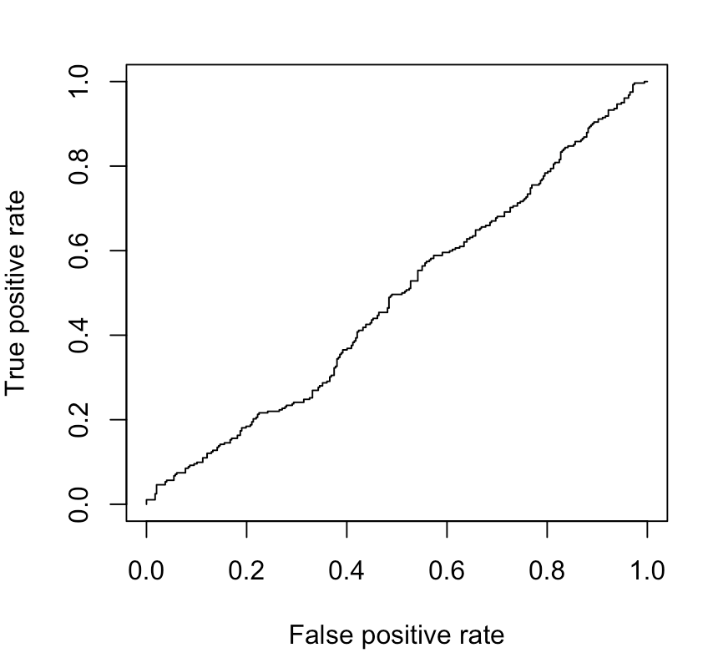
Logistic regression was used to predict the probability of a daily rise or fall, and the accuracy was 55%

Slide 23
Generalized Linear Model
From Generalized Linear Model we can see that the closing price of a stock can be predicted by establishing a regression model, however, the real value is far away from the model result. Around 25% error rate in the regression model compare with the real closing price. I used the model generated on the training set to predict outcomes for validation set and calculated the test error rate, the percentage of the model misclassified an outcome as compared to the observed results. In general, linear regression analysis does not seem to be suitable for predicting stock prices.
I use logistic regression to estimate that the model correctly predicted that the market opening price order to go up on 13 days and that it order to go down on 669 days, for a total of 669 + 13 = 682 correct predictions. Among them, the error rate reaches 1-0.5421304=0.4578696, which means the error rate of logistic regression is about 46%. According to the observation, we can know that the Generalized Linear Model is not very accurate in predicting stocks.

Slide 24
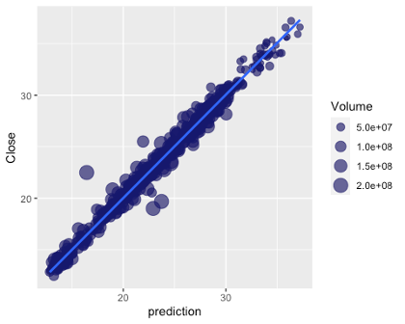
Conclusion and Future Research
Insight gain
Short-term investment in this stock is not an ideal strategy
November and December are low buying times
Future Research
Other creative and effective methods
Model can be modified
Study the short selling mechanism

Slide 25

Thank you!
Questions?

